Slide 1
Container

Slide 2


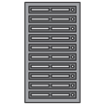
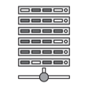



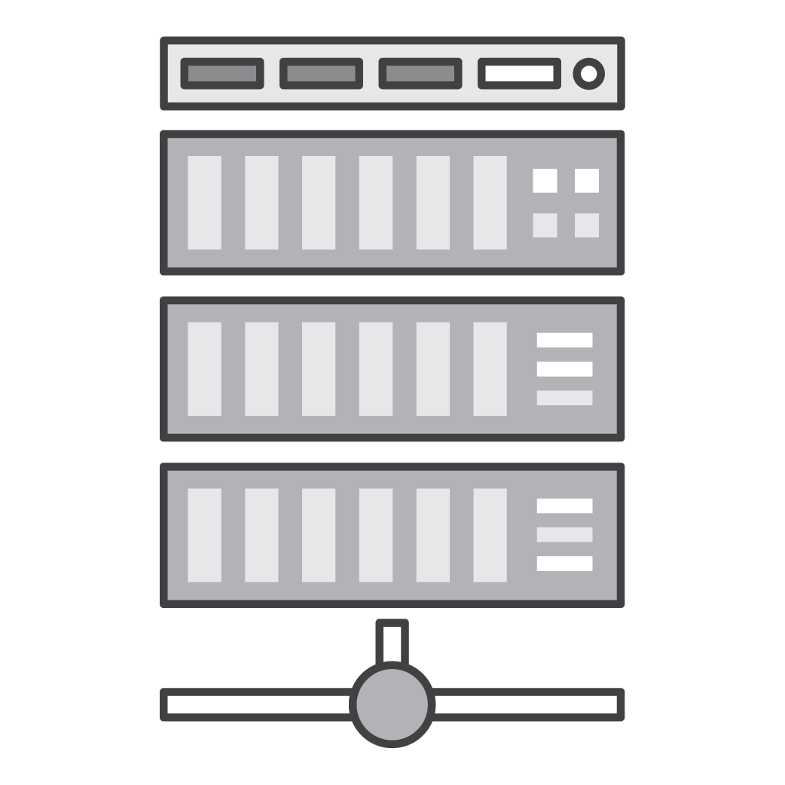
The Problem
Static website
Web fronted
Background workers
User DB
Analytics DB
Queue
 | Dev VM | QA Server | Single Prod Server | Onsite Cluster | Public Cloud | Contributor’s laptop | Customer Servers
Different application stacks
Different hardware deployment environments
How to run all applications across different environments?
How to easily migrate from one environment to another?

Slide 3
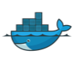
The Solution
Static website
Web fronted
Background workers
User DB
Analytics DB
Queue
 | Dev VM | QA Server | Single Prod Server | Onsite Cluster | Public Cloud | Contributor’s laptop | Customer Servers
Unit of software delivery
Lightweight, portable, consistent
Deploy and run everywhere
Deploy and run anything

Slide 4
What is a container?
A lightweight, stand-alone, executable package of software that includes all dependencies: code, runtime, system tools, system libraries, settings.
Containers isolate software from its surroundings
development and staging environments
help reduce conflicts between teams running different software on the same infrastructure.
Long history: chroot, FreeBSD Jails, Solaris Containers, OpenVZ, LXC
Docker simplified creation/management/operation of containers

Slide 5
What is a container?
Containers share a machine's OS kernel.
They start instantly¹ and use less compute and RAM.
Images are constructed from filesystem layers and share common files. This minimizes disk usage and image downloads are much faster.
Notes:
Windows containers don't honor the cgroup RAM and CPU settings?
https://azure.microsoft.com/en-us/blog/containers-docker-windows-and-trends/

Slide 6
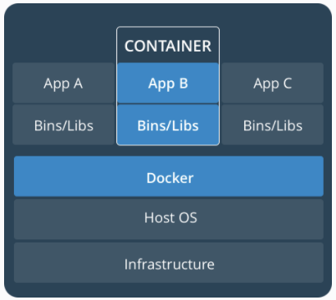
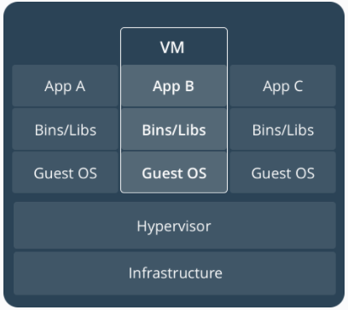
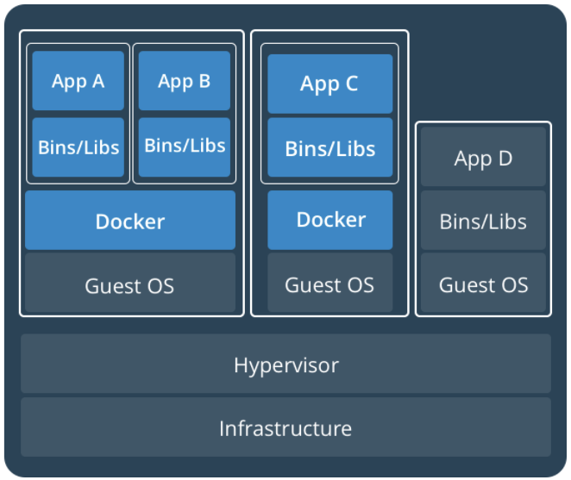
Virtual Machines vs Containers
Containers on VMs
VMs
Containers
Notes:
Containers on VMs 엔진으로 요즘 가장 많이 쓰는 것이 Kubernetes

Slide 7
Benefits
Portable runtime application environment
Package application and dependencies in a single artifact
Run different application versions (different dependencies) simultaneously
Faster development & deployment cycles
Better resource utilization

Slide 8
Use Cases
Consistent environment between Development & Production
Service-Oriented Architectures / Microservices
Short lived workflows
Isolated environments for testing
Notes:
Makes it easier to build & deploy things more rapidly, because the environment is the same. Build the container in dev, push to test, release to prod. This can also be useful for customers running hybrid environments.
Makes it easier to keep consistent environments for SOAs or Micro-Services. Also, many of these services aren’t very resource intensive, so you can place them together on one instance.
Sometimes customers have short-lived workflows that need to setup environments (e.g. queue systems, CI jobs, etc.), which doesn’t always map too well to EC2’s per-hour billing model. Docker can be one workaround, allowing them to push & pop containers on to the instance.
Can be useful for isolated execution when testing user code. E.g. Go Playground or similar.

Slide 9
Docker Engine
Notes:
https://docs.docker.com/engine/docker-overview/#docker-engine
A server which is a type of long-running program called a daemon process (the dockerd command).
A REST API which specifies interfaces that programs can use to talk to the daemon and instruct it what to do.
A command line interface (CLI) client (the docker command).
The Docker daemon
The Docker daemon (dockerd) listens for Docker API requests and manages Docker objects such as images, containers, networks, and volumes. A daemon can also communicate with other daemons to manage Docker services.
The Docker client
The Docker client (docker) is the primary way that many Docker users interact with Docker. When you use commands such as docker run, the client sends these commands to dockerd, which carries them out. The docker command uses the Docker API. The Docker client can communicate with more than one daemon.

Slide 10
Container registries
A Docker registry stores Docker images
Docker Hub is a public registry that anyone can use, and Docker is configured to look for images on Docker Hub by default.
https://hub.docker.com/
Amazon EC2 Container Registry (Amazon ECR)
Fully managed Docker container registry
Makes it easy for developers to store, manage, and deploy container images

Slide 11
Container registries
docker pull or docker run: required images are pulled from your configured registry.
docker push: your image is pushed to your configured registry.

Slide 12
Docker Image
A read-only template with instructions for creating a Docker container.
Often, an image is based on another image, with some additional customization.
E.g, you may build an image which is based on the Ubuntu image, but installs the Apache web server and your application, as well as the configuration details needed to make your application run.
Create your own images.
Use images created by others and published in a registry.

Slide 13
Docker Image
To build your own image, you create a Dockerfile with a simple syntax for defining the steps needed to create the image and run it.
Each instruction in a Dockerfile creates a layer in the image.
When you change the Dockerfile and rebuild the image, only those layers which have changed are rebuilt.
This is part of what makes images so lightweight, small, and fast, when compared to other virtualization technologies.
Creating Effective Images, video, slides

Slide 14
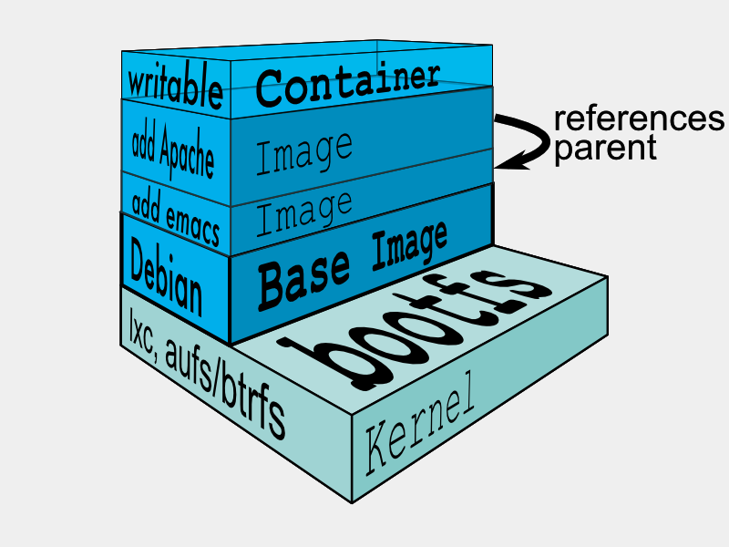
Docker Image Layers
Union file system creates layers
aufs, overlay2, zfs, etc
Image composed on read-only (RO) layers
Containers get a thin read-write layer
Container layer removed when container is deleted
Store persistent data on a separate data volume
Copy-on-Write strategy used when modifying files from RO lower layers
Notes:
https://docs.docker.com/engine/userguide/storagedriver/imagesandcontainers/#copying-makes-containers-efficient
$ ls /var/lib/docker/<storage-driver>/layers/
$ docker info # to see which union file system is used
https://blog.docker.com/2015/10/docker-basics-webinar-qa/
What is a union file system?
A union file system is a file system that amalgamates a collection of different file systems and directories (called branches) into a single logical file system.
Are Docker Storage Drivers and Volumes the same thing?
No, they are actually quite different.
A storage driver is how docker implements a particular union file system. Keeping with are “batteries included, but replaceable” philosophy, Docker supports a number of different union file systems. For instance, Ubuntu’s default storage driver is AUFS, where for Red Hat and Centos it’s Device Mapper.
A volume is subdirectory in a container’s file system that exists outside of the union file system. Unless you explicitly commit changes made to a Docker container during run time to a new image, they are lost when the container is destroyed. Volumes, by contrast, will not be automatically deleted when a container is removed (you can, of course, tell Docker to remove any volumes when removing a container).
For few of applications like Oracle 12g RAC which requires dynamic kernel tuning and fencing concept, will Docker work?
It might work, but it’s not something we advocate as a good use case. Docker is designed for microservices or distributed applications. . Each container should, ideally, perform a single function. You tie those containers together to create complex applications. Large monolithic applications like Oracle, are not a particularly good use case for containers.

Slide 15
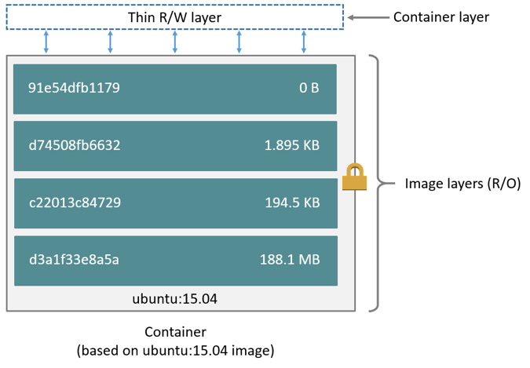
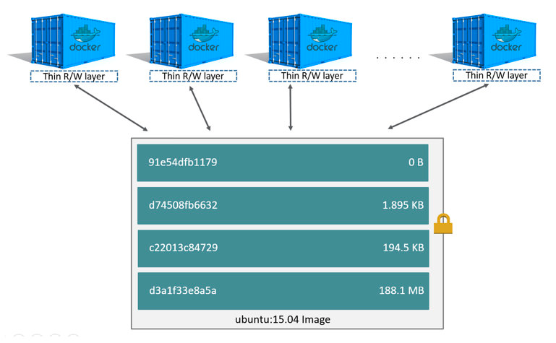
Docker Image Layers
Notes:
Left: Docker Image
Right: Docker Image instantiated into containers which have a thin R/W layer.

Slide 16
Docker Containers
A runnable instance of an image.
Create, run, stop, move, or delete a container using the Docker API or CLI.
Connect a container to one or more networks, attach storage to it, create a new image based on its current state.
By default, a container is relatively well isolated from other containers and its host machine.

Slide 17
Docker Containers
You can control how isolated a container’s network, storage, or other underlying subsystems are from other containers or from the host machine.
A container is defined by its image as well as any configuration options you provide to it when you create or run it.
When a container stops, any changes to its state that are not stored in persistent storage disappears.

Slide 18
Docker Architecture
Notes:
https://docs.docker.com/engine/docker-overview/#docker-architecture
Docker uses a client-server architecture. The Docker client talks to the Docker daemon, which does the heavy lifting of building, running, and distributing your Docker containers. The Docker client and daemon can run on the same system, or you can connect a Docker client to a remote Docker daemon. The Docker client and daemon communicate using a REST API, over UNIX sockets or a network interface.

Slide 19
Docker Workflow
Find an Image on registry (Docker Hub, ECR, etc.)
Pull an Image from registry
Run an Image
Stop a Container
Modify & rebuild Image
Rerun Image
Push Image
Remove a Container
Remove an Image

Slide 20
Docker CLI
docker build # Build an image from a Dockerfile
docker info # Display system-wide information
docker images # List all images on a Docker host
docker run # Run an image
docker ps # List all running and stopped instances
docker stop # Stop a running instances
docker rm # Remove an instance
docker rmi # Remove an image
docker pull # Download an image from registry
docker push # Upload an image to the registry

Slide 21
Images are Built from a Dockerfile
FROM ubuntu:14.04
RUN apt-get update
RUN apt-get install -y redis-server
EXPOSE 6379
ENTRYPOINT ["/usr/bin/redis-server"]
Notes:
Ref: https://docs.docker.com/engine/reference/builder/
To build this, copy the above Dockerfile to instructions to a Dockerfile and run something like the following:
docker build -t demo/redis .
docker history demo/redis
docker run -i -tt demi/redis
----
The above show how to install redis.
In practice, simply pullredis: https://hub.docker.com/_/redis/

Slide 22
Dockerfile Reference
FROM <image>:<tag> Sets the base image. Must be first instruction in Dockerfile.
RUN <command> Executes any commands in a new layer on top of the current image and commit the results.
CMD [“exec”, “param1”, “param2”] Sets the command to be executed when running the image.
ENTRYPOINT [“exec”, “param1”, “param2”] Configures a container that will run as an executable.
Notes:
https://docs.docker.com/engine/reference/builder/#cmd
CMD vs. ENTRYPOINT: http://crosbymichael.com/dockerfile-best-practices.html

Slide 23
Dockerfile Reference
EXPOSE <port> Informs Docker that the container listens on the specified network ports at runtime.
ENV <key> <value> Sets the environment variable <key> to the value <value>.
ADD <src> <dest> Copies new files, directories or remote file URLs from <src> and adds them to the filesystem of the container at the path <dest>. *
COPY <src> <dest> Copies new files or directories from <src> and adds them to the filesystem of the container at the path <dest>. *
*ADD or COPY - https://docs.docker.com/engine/articles/dockerfile_best-practices/#add-or-copy
Notes:
https://docs.docker.com/engine/userguide/eng-image/dockerfile_best-practices/#add-or-copy
COPY is preferred

Slide 24
Dockerfile Reference
VOLUME <path> Creates a mount point with the specified name.
USER <user> Sets the user name or UID to use when running the image and for any RUN, CMD and ENTRYPOINT instructions that follow it.
Notes:
ONBUILD [instruction] Adds to the image a trigger instruction to be executed at a later time, when the image is used as the base for another build.

Slide 25

Dockerfile examples
FROM ubuntu CMD echo “Hello world”
FROM openjdk
COPY target/hello.jar /usr/src/hello.jar CMD java -cp /usr/src/hello.jar org.example.App

Slide 26
Dockerfile examples
FROM centos:7
RUN yum -y --setopt=tsflags=nodocs update && \ yum -y --setopt=tsflags=nodocs install httpd && \ yum clean all
EXPOSE 80 # Simple startup script to avoid some issues observed with container restart
ADD run-httpd.sh /run-httpd.sh
RUN chmod -v +x /run-httpd.sh
CMD ["/run-httpd.sh"]
Notes:
$ wget https://raw.githubusercontent.com/CentOS/CentOS-Dockerfiles/master/httpd/centos7/Dockerfile
$ wget https://github.com/CentOS/CentOS-Dockerfiles/raw/master/httpd/centos7/run-httpd.sh
$ docker build --rm -t sajee/httpd
$ docker run -d -p 8080:8080 sajee/httpd
$ curl http://localhost:8080

Slide 27
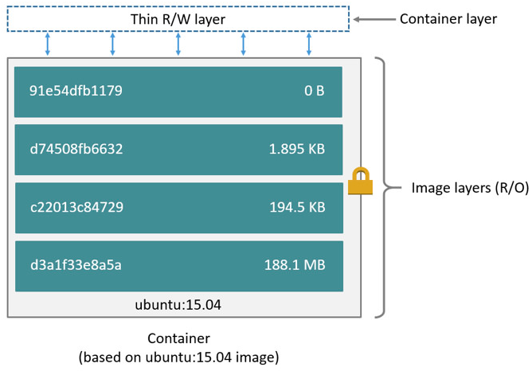
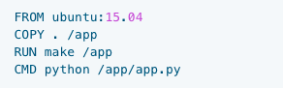
Images vs. Containers
Containers: running instance of an image.
Containers have a top level writable layer.
AWS analogy: EC2 AMIs vs EC2 Instances
$ docker build --rm -t my-app .
Notes:
https://docs.docker.com/engine/userguide/storagedriver/imagesandcontainers/
---
Image layers stored in /var/lib/docker/

Slide 28
Optional: follow along or just watch
Launch Amazon Linux.
Install Docker
http://amzn.to/2v285f3

Slide 29
Typical CLI commands
$ docker images
$ docker search ubuntu
$ docker pull ubuntu
$ docker images
$ docker history ubuntu
$ docker run -it ubuntu /bin/bash
Execute some commands
In another shell:
$ docker ps –as
$ docker inspect a7a4dc398be2 [from the PS command above]
$ docker stop a7a4dc398be2
$ docker rm a7a4dc398be2
$ docker rmi ubuntu
$ docker images
Notes:
$ docker ps –as. # to see all containers, stopped also.
$ docker rm -f CONTAINER_ID # stops/removes container
------
$ docker search ubuntu
NAME DESCRIPTION STARS OFFICIAL AUTOMATED
ubuntu Ubuntu is a Debian-based Linux operating s... 6325 [OK]
rastasheep/ubuntu-sshd Dockerized SSH service, built on top of of... 92 [OK]
ubuntu-upstart Upstart is an event-based replacement for ... 76 [OK]
neurodebian NeuroDebian provides neuroscience research... 37 [OK]
ubuntu-debootstrap debootstrap --variant=minbase --components... 30 [OK]
32bit/ubuntu Ubuntu for i386 (32bit) 30
armhf/ubuntu Ubuntu is a Debian-based Linux operating s... 27

Slide 30
Thank you!

